Slide 1
SOFTWARE ENGINEERING AND PROJECT MANAGEMENT
Ritwik Gupta (RA1911003010405) Siddharth Chowdhary(RA1911003010407) Alinjar Das(RA1911003010409)

Slide 2
Train TickeTing SySTem
ABSTRACT
We have decided to build a unique and easy to use train ticketing system. User can book tickets for western, central and harbour lines and fare is calculated according to station distance.The user will have the facility to check the train details and book the train he/she wants. The user can check the PNR status of the booked train. Here the servers are present on the stations. Users can book tickets anytime and anywhere hassle free. Our system allows users to thus book tickets through their android device. We also have admin access for updating train details.
HISTORY APPLICATIONS
From what I remember from my childhood days, every station the train passes by had a quota of seats. For example a Bangalore-Chennai train had (say) 100 seats reserved in the train for Bangalore. So when a person approaches the ticket counter in Bangalore and asks for a seat, they can look up their records and see how many seats are available from Bangalore and allot a ticket. All other stations en-route will have a similar quota allocated.
Now, when a station runs out of tickets from their quota, they provide you a waiting list ticket. Later at some point, all the stations will provide their individual database, identify if
any station has unused seats and allocate the same to the waiting list passengers.
This method was quite a tedious task and was prone to a lot
of errors. I have heard my older relatives talking about

Slide 3
getting a confirmed ticket when they did the reservation and when the chart was published, their names were not present. Of course manual error could happen.
It should also be noted that unlike the system today, it was not possible to know if your waiting list ticket is confirmed or not, until the chart is published.
MODULES
Ticket Reservation: The user can reserve tickets Checking PNR Status : User can check the PNR status of the booked train.
Checking train details : User can check the details such as TRAIN NAME,NUMBER,CLASS,STARTING PT.,DESTINATION
Ticketing facility: The user can cancel his/her reserved ticket just by giving the PNR number.
Admin access : The admin can access the train details and modify them by logging in using a password.
PROGRAMMING LANGUAGE AND DATABASE USED:
1.Python 3
Advantages:
It helps passengers get tickets with ease.
Passengers need not stand in queues for getting ticket. No need to print tickets.
Disadvantages:
Security and ticket duplication issue.
Railway fare and rates must be updated regularly.
Applications:
Local train systems in India. Bus systems in India.

Slide 4
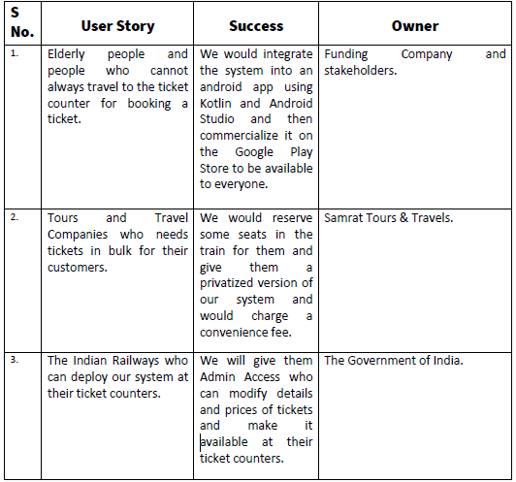
USER STORY TEMPLATE

Slide 5
STAKEHOLDER'S REGISTER
Prepared By: Ritwik Gupta, Siddharth Chowdhary, Alinjar Das
Date: 03/03/2021
Project Stakeholder Name | Specific Information Needs | Project Interest | Impact On Project | Role
 | Types and frequency of information | Specific areas of interest and participation | Positive,Negative, Influencer, Supporter, Roadblock | Decision Maker, Collaborator, Consultant, Information Recipient
Chief Executive Officer(CEO) | Total management, Resources and finance allocating | Leader and organisation head | Influencer, Supporter, Roadblock | Decision Maker
PROJECT MANAGER | Managing project for achieving objectives,Applying skills for solving problems | Project management | Influencer | Decision Maker
DEVELOPMENT TEAM MANAGER | Specific development task coordination | Specific development domain manager | Supporter | Decision Maker
DEVELOPER | Designing, Programming | Skilled programmer and Problem solver | Supporter, Positive | Participant
TEST ENGINEER | Testing for ensuring proper functioning of systems | Tester,Using testing tools and software | Supporter, Negative | Participant
BUSINESS ANALYST | Improving services through data analysis | Analytical and conceptual thinker Influencing stakeholders | Influencer | Consultant
OPERATIONS MANAGER | Managing inner workings of business | Managing planning,control and performance improvement | Supporter | Collaborator
EMPLOYEES | Picking and packaging items | Fulfilling demands of organisation | Supporter | Collaborator

Slide 6
Requirements Template:
AIM: To identify and document the requirements of a software systems Executive summary:
The Android Train Booking System is a way to improvise booking experience. User can book tickets for western, central and harbour lines and fare is calculated according to station distance. The user will have the facility to check the train details and book the train accordingly. They can also check the PNR status of the booked train. Our system will allow the users to book through their android device. We also have admin access for updating the train details.
Project scope:
From an end-user perspective, the Online Train Ticketing System Project consists of three functional elements:
Account Creation
Updating data
Booking Ticket
Develop Modules:
1. Registration of Passengers
We need to register the passengers to the system so as create an account for smooth experience. This will take the basic details of the passengers:
Name
Date of Birth
Email Id
Mobile number
All the details will be given to the passengers before generating the ticket to verify for any errors before booking.
2. Updating the system
The system will be updated frequently by the organisation for smooth and hassle-free experience. Passengers will be able to view real-time availability of seats and thus book the trains accordingly.

Slide 7
3. Booking Tickets
The passengers can use this interface by logging in and entering the travel details. List of available trains with number of vacant seats will be displayed. Passengers can then book their tickets accordingly.
Passengers will be able to use variety of features such as:
Checking live train status
Checking live availability of seats
Booking tickets instantly
Reporting an issue
4. Payment Method
Passengers will be able to pay using Debit/Credit card, Bank transfer, UPI.
More features may be added in later updates as per requirements and demands
Requirements
-Functional Requirements:
Passenger registration
Operator registration
Server at every/major stations
-Non-Functional Requirements:
Efficiency
Security
Reliability

Slide 8
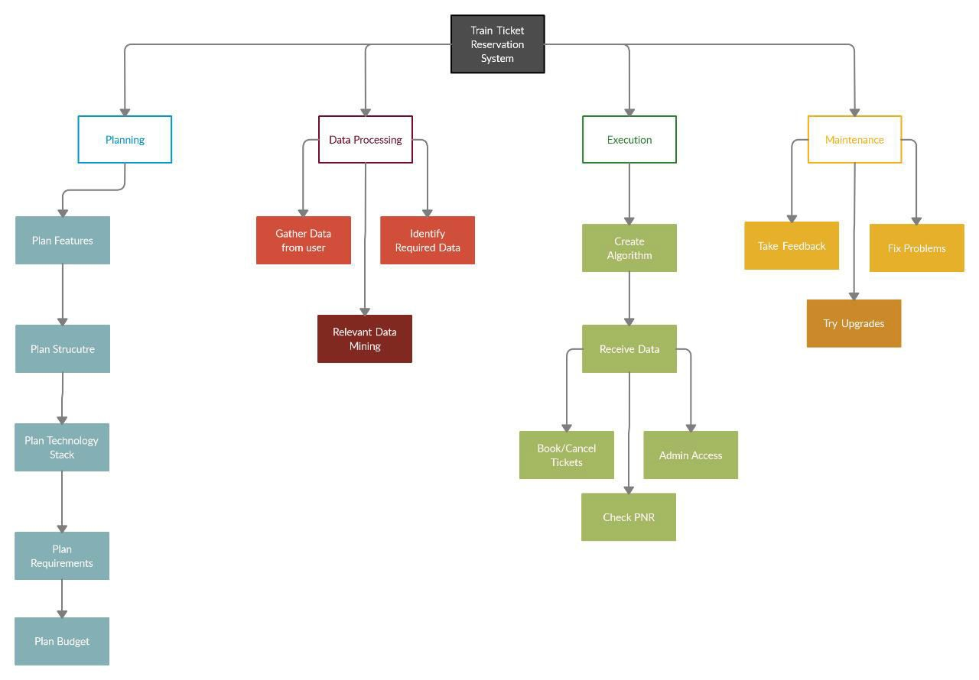
WBS
RISK ANALYSIS
Some risks associated with our project are –
Poor recognition of platform
Incorrect information provided by the passengers
System lags
System not updated with latest information
Payment gateway not working properly
We have tried our best to address all these risks in our model.

Slide 9
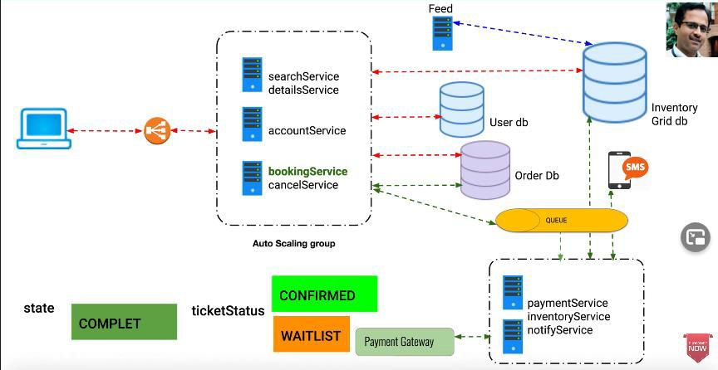
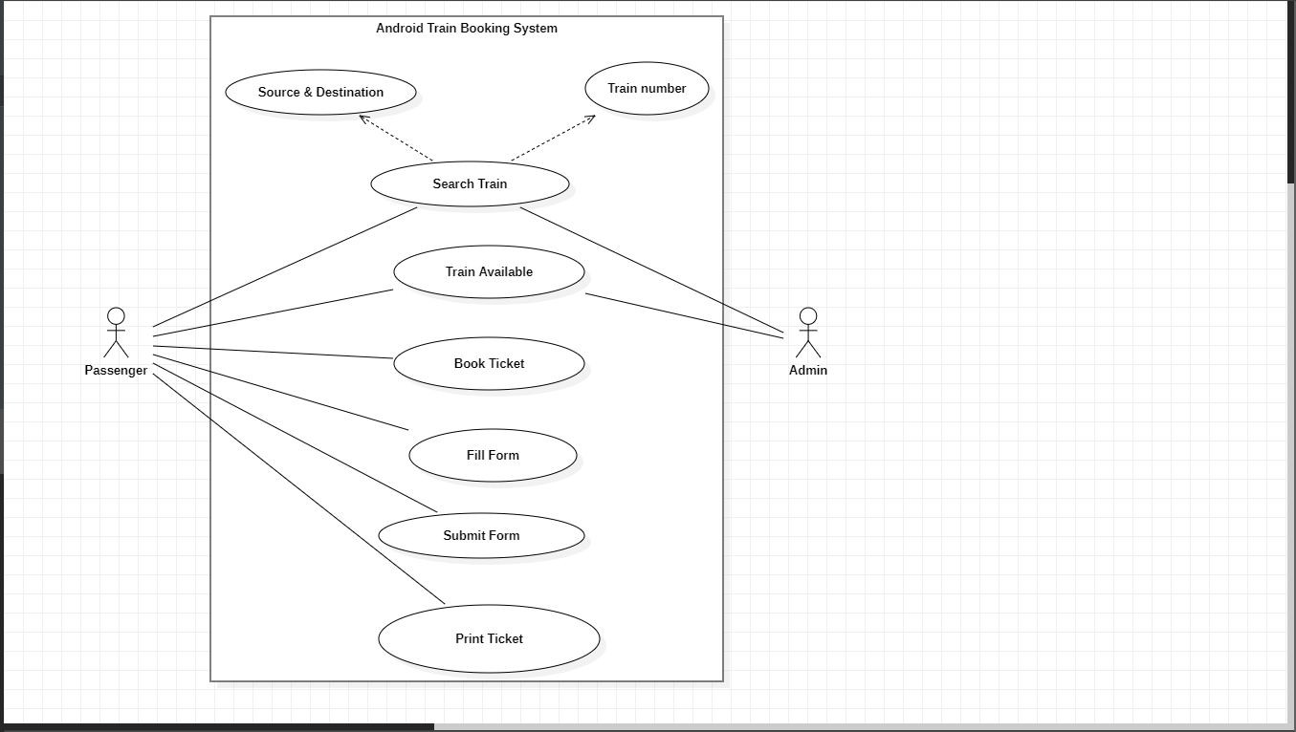
Architecture Diagram
Use case Diagram
The above use case diagram shows how the 2 actors, passengers and admin, can use, access and modify the data available in the application.

Slide 10
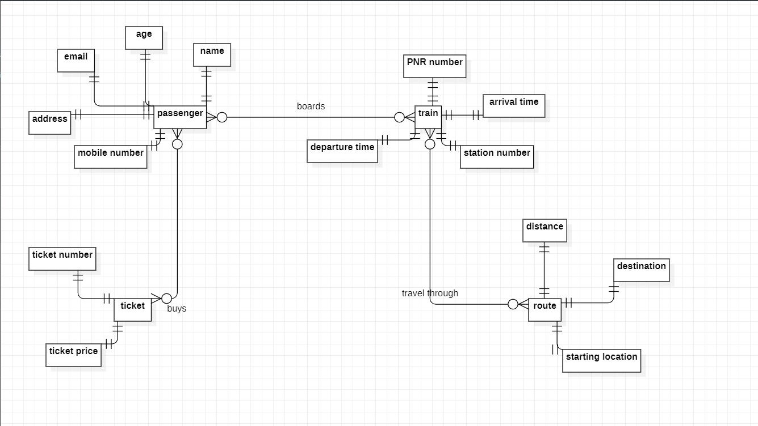
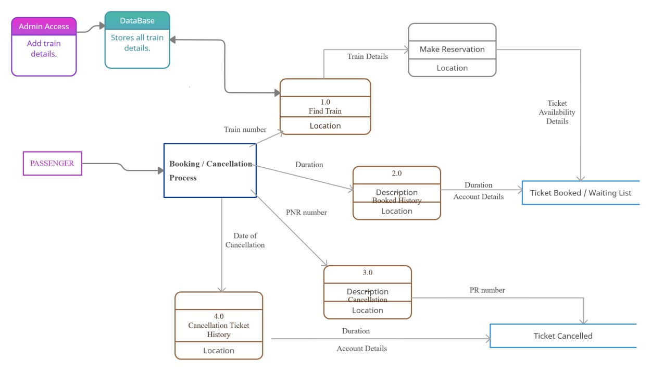
ERD (Entity Relationship Diagram)
DFD (Data Flow Diagram)

Slide 11
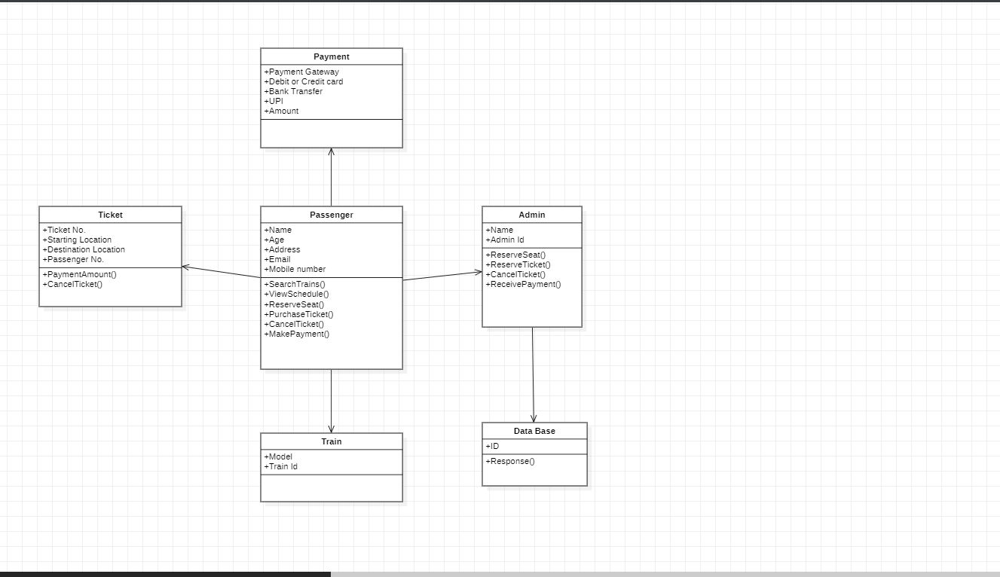
Class Diagram
The above class diagram shows the different classes like payment, passenger, train, etc. and also shows how each and every class are related to one another.

Slide 12
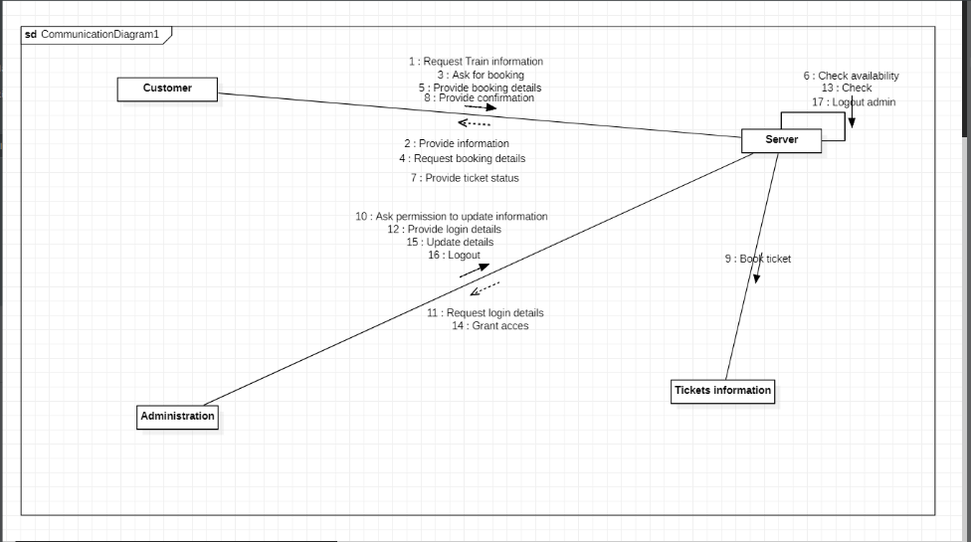
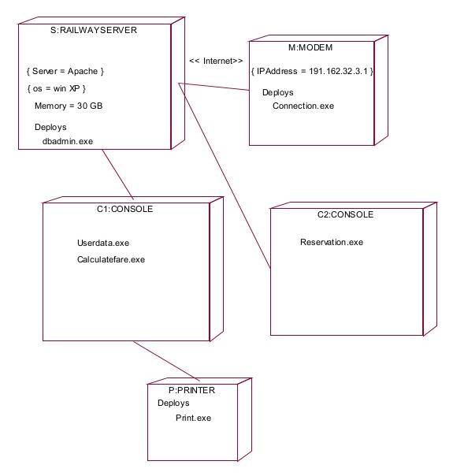
Collaboration Diagram
Deployment Diagram

Slide 13
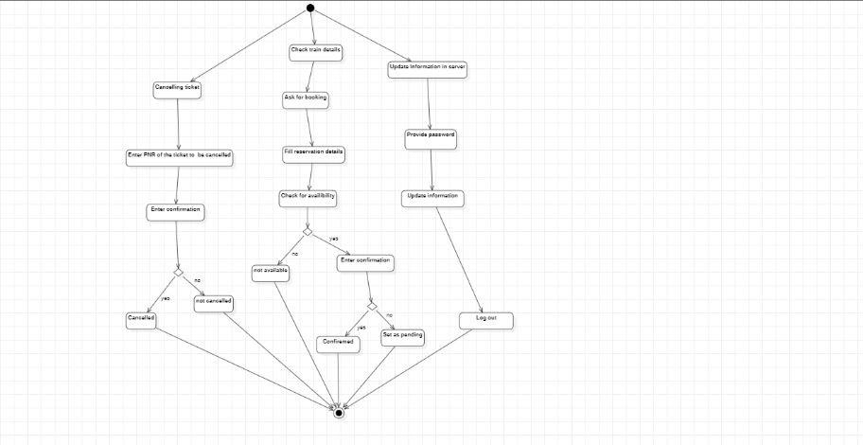
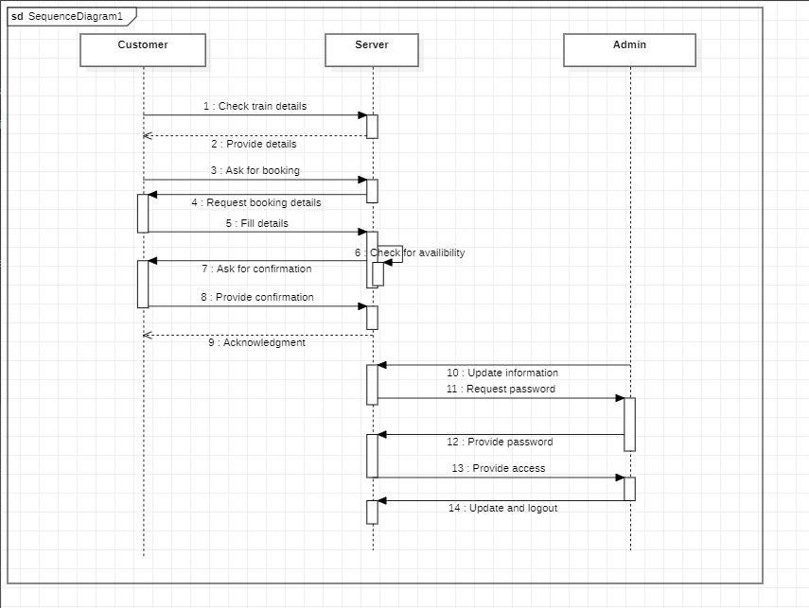
State chart Diagram
Sequence Diagram

Slide 14
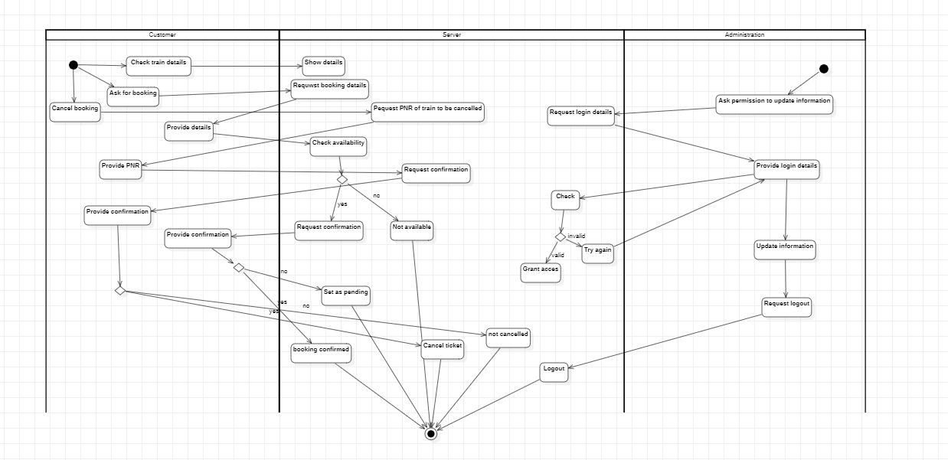
Activity Diagram

Slide 15
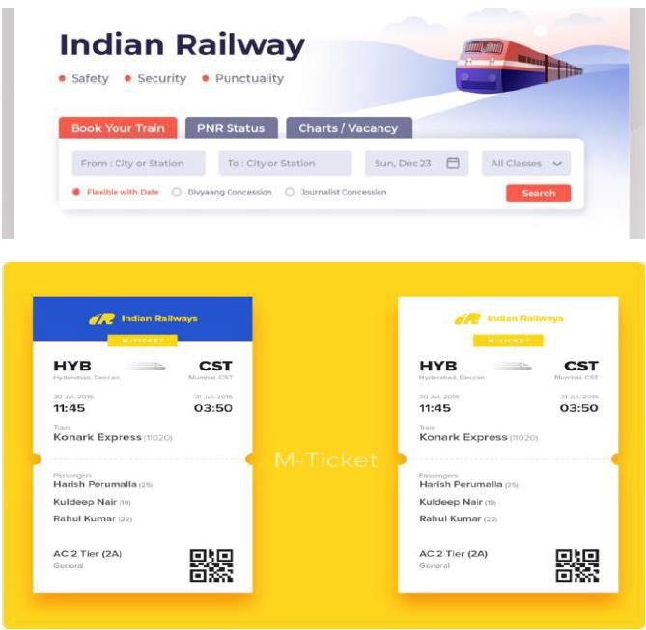
Sample front-end

Slide 16
Application code
#______HEADER______
# -- coding: utf-8 --
from pickle import load,dump
import time
import random
import os
#________CLASS TICKETS______
class tickets:
def _init_(self):
self.no_ofac1stclass=0
self.totaf=0
self.no_ofac2ndclass=0
self.no_ofac3rdclass=0
self.no_ofsleeper=0
self.no_oftickets=0
self.name=''
self.age=''
self.resno=0
self.status='' \
#___RETURNS RESERVATION NUMBER____
def ret(self):
return(self.resno)
#____RETURNS NAME____
def retname(self):
return(self.name)
#______DISPLAYS THE DATA______
def display(self):

Slide 17
f=0
fin1=open("tickets.dat","rb")
if not fin1:
print "ERROR"
else:
print
n=int(raw_input("ENTER PNR NUMBER : "))
print "\n\n"
print ("FETCHING DATA . . .".center(80))
time.sleep(1)
print
print('PLEASE WAIT...!!'.center(80))
time.sleep(1)
#os.system('cls')
try:
while True:
tick=load(fin1)
if(n==tick.ret()):
f=1
print "="*80
print("PNR STATUS".center(80))
print"="*80
print
print "PASSENGER'S NAME :",tick.name
print
print "PASSENGER'S AGE :",tick.age
print
print "PNR NO :",tick.resno
print

Slide 18
print "STATUS :",tick.status
print
print "NO OF SEATS BOOKED : ",tick.no_oftickets
print
except:
pass
fin1.close()
if(f==0):
print
print "WRONG PNR NUMBER..!!"
print
def pending(self):
self.status="WAITING LIST"
print "PNR NUMBER :",self.resno
print
time.sleep(1.2)
print "STATUS = ",self.status
print
print "NO OF SEATS BOOKED : ",self.no_oftickets
print
def confirmation (self):
self.status="CONFIRMED"
print "PNR NUMBER : ",self.resno
print
time.sleep(1.5)
print "STATUS = ",self.status
print
def cancellation(self):
z=0

Slide 19
f=0
fin=open("tickets.dat","rb")
fout=open("temp.dat","ab")
print
r= int(raw_input("ENTER PNR NUMBER : "))
try:
while(True):
tick=load(fin)
z=tick.ret()
if(z!=r):
dump(tick,fout)
elif(z==r):
f=1
except:
pass
fin.close()
fout.close()
os.remove("tickets.dat")
os.rename("temp.dat","tickets.dat")
if (f==0):
print
print "NO SUCH RESERVATION NUMBER FOUND"
print
time.sleep(2)
# os.system('cls')
else:
print

Slide 20
print "TICKET CANCELLED"
print
#_______RESERVES THE TICKET______
def reservation(self):
trainno=int(raw_input("ENTER THE TRAIN NO:"))
z=0
f=0
fin2=open("trdetails.dat")
fin2.seek(0)
if not fin2:
print "ERROR"
else:
try:
while True:
tr=load(fin2)
z=tr.gettrainno()
n=tr.gettrainname()
if (trainno==z):
print
print "TRAIN NAME IS : ",n
f=1
print
print "-"*80
no_ofac1st=tr.getno_ofac1stclass()
no_ofac2nd=tr.getno_ofac2ndclass()
no_ofac3rd=tr.getno_ofac3rdclass()
no_ofsleeper=tr.getno_ofsleeper()
if(f==1):
fout1=open("tickets.dat","ab")
print
self.name=raw_input("ENTER THE PASSENGER’S NAME")

Slide 21
print
self.age=int(raw_input("PASSENGER'S AGE : "))
print
print"\t\t SELECT A CLASS YOU WOULD LIKE TO TRA
VEL IN :- "
print "1.AC FIRST CLASS"
print
print "2.AC SECOND CLASS"
print
print "3.AC THIRD CLASS"
print
print "4.SLEEPER CLASS"
print
c=int(raw_input("\t\t\tENTER YOUR CHOICE = "))
#os.system('cls')
amt1=0
if(c==1):
self.no_oftickets=int(raw_input("ENTER NO_O
F FIRST CLASS AC SEATS TO BE BOOKED : "))
i=1
while(i<=self.no_oftickets):
self.totaf=self.totaf+1
amt1=1000*self.no_oftickets
i=i+1

Slide 22
print
print "PROCESSING. .",
time.sleep(0.5)
print ".",
time.sleep(0.3)
print'.'
time.sleep(2)
# os.system('cls')
print "TOTAL AMOUNT TO BE PAID = ",amt1
self.resno=int(random.randint(1000,2546))
x=no_ofac1st-self.totaf
print
if(x>0):
self.confirmation()
dump(self,fout1)
break
else:
self.pending()
dump(tick,fout1)
break
elif(c==2):
self.no_oftickets=int(raw_input("ENTER NO_O
F SECOND CLASS AC SEATS TO BE BOOKED : "))
i=1
while(i<=self.no_oftickets):
self.totaf=self.totaf+1
amt1=900*self.no_oftickets
i=i+1

Slide 23
print
print "PROCESSING. .",
time.sleep(0.5)
print ".",
time.sleep(0.3)
print'.'
time.sleep(2)
#os.system('cls')
print "TOTAL AMOUNT TO BE PAID = ",amt1
self.resno=random.randint(1000,2546)
x=no_ofac2nd-self.totaf
print
if(x>0):
self.confirmation()
dump(self,fout1)
break
else:
self.pending()
dump(tick,fout1)
break
elif(c==3):
self.no_oftickets=int(raw_input("ENTER NO_O
F THIRD CLASS AC SEATS TO BE BOOKED : "))
i=1
while(i<=self.no_oftickets):
self.totaf=self.totaf+1
amt1=800*self.no_oftickets
i=i+1

Slide 24
print
print "PROCESSING. .",
time.sleep(0.5)
print ".",
time.sleep(0.3)
print'.'
time.sleep(2)
#os.system('cls')
print "TOTAL AMOUNT TO BE PAID = ",amt1
self.resno=random.randint(1000,2546)
x=no_ofac3rd-self.totaf
print
if(x>0):
self.confirmation()
dump(self,fout1)
break
else:
self.pending()
dump(tick,fout1)
break
elif(c==4):
self.no_oftickets=int(raw_input("ENTER NO_O
F SLEEPER CLASS SEATS TO BE BOOKED : "))
i=1
while(i<=self.no_oftickets):
self.totaf=self.totaf+1
amt1=550*self.no_oftickets
i=i+1
print

Slide 25
print "PROCESSING. .",
time.sleep(0.5)
print ".",
time.sleep(0.3)
print'.'
time.sleep(2)
#os.system('cls')
print "TOTAL AMOUNT TO BE PAID = ",amt1
self.resno=random.randint(1000,2546)
x=no_ofsleeper-self.totaf
print
if(x>0):
self.confirmation()
dump(self,fout1)
break
else:
self.pending()
dump(tick,fout1)
break
except:
pass
if(f==0):
time.sleep(2)
print"\n\n\n\n\n\n\t\t\t\tNO SUCH TRAINS FOUND !!"
time.sleep(2)
print
print

Slide 26
print
#_______CLASS TRAIN_______
class train:
def _init_(self):
self.trainno=0
self.no_ofac1stclass=0
self.no_ofac2ndclass=0
self.no_ofac3rdclass=0
self.no_ofsleeper=0
self.totalseats=0
self.trainname=''
self.startingpt=""
self.destination=''
#________GETS INPUT_______
def getinput(self):
print"="*80
print "\t\t\t ENTER THE TRAIN DETAILS"
print
print"="*80
self.trainname=raw_input("ENTER THE TRAIN NAME : ").upper()
print
self.trainno=int(raw_input("ENTER THE TRAIN NUMBER: "))
print
self.no_ofac1stclass=int(raw_input("ENTER NO_OF AC FIRST CLASS
SEATS TO BE RESERVED : "))
print
self.no_ofac2ndclass=int(raw_input("ENTER NO_OF AC SECOND CLASS
SEATS TO BE RESERVED : "))
print

Slide 27
self.no_ofac3rdclass=int(raw_input("ENTER NO_OF AC THIRD CLASS
SEATS TO BE RESERVED : "))
print
self.no_ofsleeper=int(raw_input("ENTER NO_OF SLEEPER CLASS SEAT
S TO BE RESERVED : "))
print
self.startingpt=raw_input("ENTER THE STARTING POINT : ")
print
self.destination=raw_input("ENTER THE DESTINATION POINT : ")
#os.system('cls')
#______DISPALYS DATA______
def output(self):
print"="*80
print
print "THE ENTERED TRAIN NAME IS : ",self.trainname
print "THE TRAIN NUMBER IS : ",self.trainno
print "STARTING POINT ENTERED IS : ",self.startingpt
print "DESTINATION POINT ENTERED IS : ",self.destination
print "NO_OF AC FIRST CLASS SEATS RESERVED ARE :",self.no_ofac1
stclass
print "NO_OF AC SECOND CLASS SEATS RESERVED ARE :",self.no_ofac
2ndclass
print "NO_OF AC THIRD CLASS SEATS RESERVED ARE :",self.no_ofac3
rdclass
print "NO_OF SLEEPER CLASS SEATS RESERVED ARE :",self.no_ofslee
per
print

Slide 28
print "="*80
#__RETURNS TRAIN NAME,NUMBER,CLASS,STARTING PT.,DESTINATION_____
def gettrainname(self):
return (self.trainname)
def gettrainno(self):
return(self.trainno)
def getno_ofac1stclass(self):
return(self.no_ofac1stclass)
def getno_ofac2ndclass(self):
return(self.no_ofac2ndclass)
def getno_ofac3rdclass(self):
return(self.no_ofac3rdclass)
def getno_ofsleeper(self):
return (self.no_ofsleeper)
def getstartingpt(self):
return (self.startingpt)
def getdestination(self):
return (self.destination)
#______MAIN_______
#___CALLS ALL THE FUNCTIONS ACCORDING TO USER CHOICE._______
def menu():
tr=train()
tick=tickets()
print

Slide 29
print "WELCOME TO RAILWAY RESERVATION PORTAL".center(80)
while True:
print
print "="*80
print " \t\t\t\t RAILWAY"
print
print "="*80
print
print "\t\t\t1. **UPDATE TRAIN DETAILS."
print
print "\t\t\t2. TRAIN DETAILS. "
print
print "\t\t\t3. RESERVATION OF TICKETS."
print
print "\t\t\t4. CANCELLATION OF TICKETS. "
print
print "\t\t\t5. DISPLAY PNR STATUS."
print
print "\t\t\t6. QUIT."
print"** - office use......"
ch=int(raw_input("\t\t\tENTER YOUR CHOICE : "))
# os.system('cls')
print "\n\n\n\n\n\n\n\n\n\n\n\n\n\n\n\n\n\n\n\n\n\n\n\n\n\n
\n\t\t\t\t\t\t\tLOADING. .",
time.sleep(1)
print ("."),
time.sleep(0.5)
print (".")
time.sleep(2)
#os.system('cls')
if ch==1:
j="123"

Slide 30
r=raw_input("\n\n\n\n\n\n\n\n\n\n\n\t\t\t\tENTER THE PA
SSWORD: ")
# os.system('cls')
if (j==r):
x='y'
while (x.lower()=='y'):
fout=open("trdetails.dat","ab")
tr.getinput()
dump(tr,fout)
fout.close()
print"\n\n\n\n\n\n\n\n\n\n\n\t\t\tUPDATING TRAI
N LIST PLEASE WAIT . .",
time.sleep(1)
print ("."),
time.sleep(0.5)
print ("."),
time.sleep(2)
#os.system('cls')
print "\n\n\n\n\n\n\n\n\n\n\n"
x=raw_input("\t\tDO YOU WANT TO ADD ANY MORE TR
AINS DETAILS ? ")
#os.system('cls')
continue
elif(j<>r):
print"\n\n\n\n\n"
print "WRONG PASSWORD".center(80)
elif ch==2:
fin=open("trdetails.dat",'rb')
if not fin:
print "ERROR"

Slide 31
else:
try:
while True:
print"*"*80
print"\t\t\t\tTRAIN DETAILS"
print"*"*80
print
tr=load(fin)
tr.output()
raw_input("PRESS ENTER TO VIEW NEXT TRAIN DETAILS")
#os.system('cls')
except EOFError:
pass
elif ch==3:
print'='*80
print "\t\t\t\tRESERVATION OF TICKETS"
print'='*80
print
tick.reservation()
elif ch==4:
print"="*80
print"\t\t\t\tCANCELLATION OF TICKETS"
print
print"="*80
print

Slide 32
tick.cancellation()
elif ch==5:
print "="*80
print("PNR STATUS".center(80))
print"="*80
print
tick.display()
elif ch==6:
quit()
raw_input("PRESS ENTER TO GO TO BACK MENU".center(80))
#os.system('cls')
print"\t\t\t\tWELCOME TO GSS RAILWAYS"
print
print"\n\n\n\n\t\t\tBy:-"
print"\t\t\t\tASIMA \n"
print "\n\n\n\n\n\n\n\n\n\n\n\n\n\n\n\n\n\n\n\n\n\n\n\n\n\n\n\t\t\t\t\t
\t\tLOADING. .",
time.sleep(1)
print ("."),
time.sleep(0.5)
print (".")

Slide 33
time.sleep(2)
#os.system('cls')
menu()
print"\t\t\t\t\n\n\n\n\n\t THANK YOU....."
print"\n\t\t\t\DONE BY:-"
print"\t\t\t\t ASIMA“
print "\n\n\n\n\n\n\n\n\n\n\n\n\n\n\n\n\n\n\n\n\n\n\n\n\n\n\n\t\t\t\t\t
\t\tLOADING. .",
time.sleep(1)
print ("."),
time.sleep(0.5)
print (".")
time.sleep(2)
#os.system('cls')

Slide 34
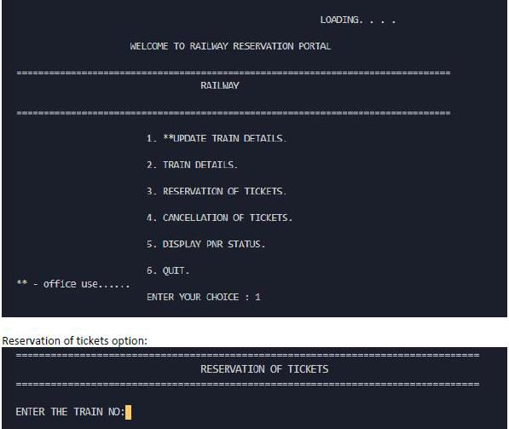
Output:
Menu & Reservation Of Tickets:

Slide 35
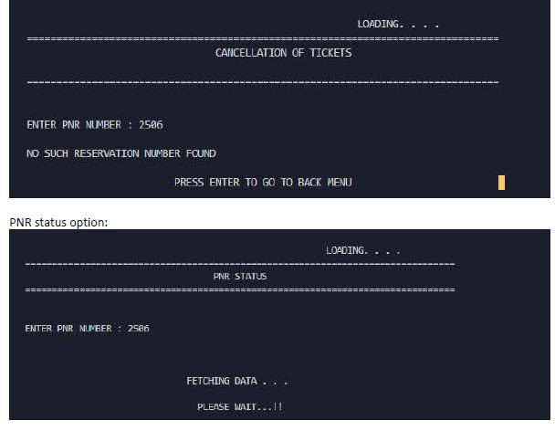
Cancellation of ticket & PNR Status Option:

Slide 36
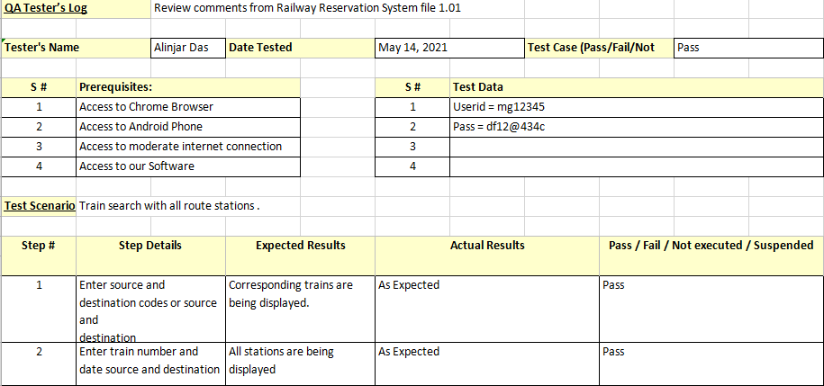
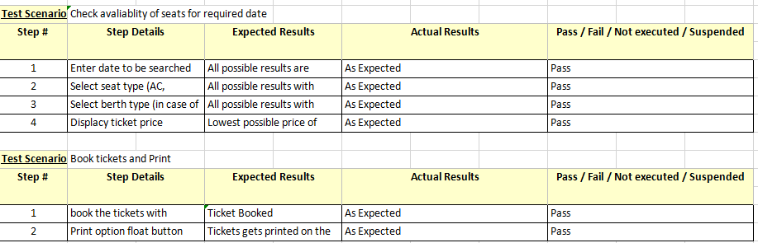
TEST CASES

